Slide 1
Handwritten Digit Recognition using Convolutional Neural Network Nivea Dabre 7364 Valencia Dias 7368

Slide 2
Install Python 3.6
Install Tensorflow
TensorFlow is extremely flexible, allowing you to deploy network computation to multiple CPUs, GPUs, servers, or even mobile systems without having to change a single line of code.
This makes TensorFlow an excellent choice for training distributed deep learning networks in an architecture agnostic way, something that Theano does not (currently) provide.

Slide 3
TensorFlow supports Python 3.5.x and 3.6.x on Windows
To install the CPU-only version of TensorFlow, enter the following command:
pip3 install --upgrade tensorflow
For installing Keras first install below dependancies.
NumPy
NumPy can also be used as an efficient multi-dimensional container of generic data. Arbitrary data-types can be defined.
This allows NumPy to seamlessly and speedily integrate with a wide variety of databases.
SciPy
SciPy contains modules for optimization, linear algebra, integration, interpolation, special functions, FFT, signal and image processing,

Slide 4
Scikit-learn
Scikit-learn is a free software machine learning library for the Python programming language.
It features various classification, regression and clustering algorithms including support vector machines, random forests, gradient boosting, k-means, and is designed to interoperate with the Python numerical and scientific libraries NumPy and SciPy.
Pillow
Pillow is a free library for the Python programming language that adds support for opening, manipulating, and saving many different image file formats.
H5py
It lets you store huge amounts of numerical data, and easily manipulate that data from NumPy.
Thousands of datasets can be stored in a single file, categorized and tagged however you want.

Slide 5
Keras
Keras is a high-level neural networks API, written in Python and capable of running on top of TensorFlow, Theano. It was developed with a focus on enabling fast experimentation.
Allows for easy and fast prototyping (through user friendliness, modularity, and extensibility).
Supports both convolutional networks and recurrent networks, as well as combinations of the two.
Matplotlib
matplotlib is a plotting library for the Python programming language and its numerical mathematics extension NumPy.
It provides an object-oriented API for embedding plots into applications using general-purpose GUI toolkits

Slide 6
Raw Optimisation
Load the MNIST dataset in Keras.
Develop and evaluate a baseline neural network model for the MNIST problem.
Implement and evaluate a simple Convolutional Neural Network for MNIST.
Implement a large convolutional neural network deep learning model for MNIST.

Slide 7
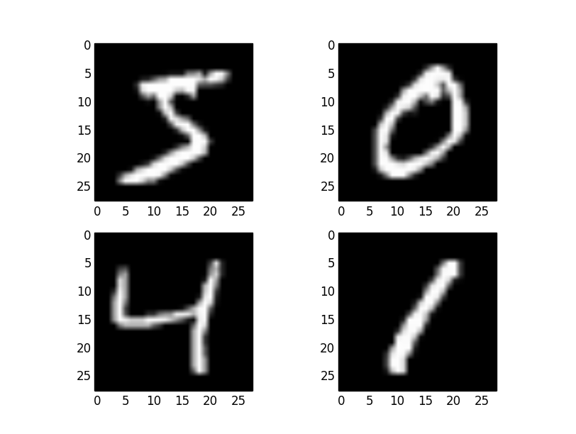
Loading the MNIST dataset in Keras
The Keras deep learning library provides a convenience method for loading the MNIST dataset.
The dataset is downloaded automatically the first time this function is called and is stored in your home directory in ~/.keras/datasets/mnist.pkl.gz as a 15MB file.
To load the MNIST dataset –
from keras.datasets import mnist

Slide 8
The dataset was constructed from a number of scanned document dataset available from the National Institute of Standards and Technology (NIST).
Images of digits were taken from a variety of scanned documents, normalized in size and centered.
Each image is a 28 by 28 pixel square (784 pixels total).
A standard spit of the dataset is used to evaluate and compare models, where 60,000 images are used to train a model and a separate set of 10,000 images are used to test it.
It is a digit recognition task.
As such there are 10 digits (0 to 9) or 10 classes to predict.
Results are reported using prediction error, which is nothing more than the inverted classification accuracy.

Slide 9
It is a digit recognition task.
As such there are 10 digits (0 to 9) or 10 classes to predict.
Results are reported using prediction error, which is nothing more than the inverted classification accuracy.
Excellent results achieve a prediction error of less than 1%. State-of-the-art prediction error of approximately 0.2% can be achieved with large Convolutional Neural Networks.

Slide 10
Develop and evaluate a baseline neural network model
In this section we will create a simple multi-layer perceptron model that achieves an error rate of 1.82%.
We will use this as a baseline for comparing more complex convolutional neural network models.
The model is a simple neural network with one hidden layer with the same number of neurons as there are inputs (784).
A rectifier activation function is used for the neurons in the hidden layer.
A softmax activation function is used on the output layer to turn the outputs into probability-like values and allow one class of the 10 to be selected as the model’s output prediction.
Logarithmic loss is used as the loss function (called categorical_crossentropy in Keras) and the efficient ADAM gradient descent algorithm is used to learn the weights.
We can now fit and evaluate the model. The model is fit over 10 epochs

Slide 11
Implement and evaluate a simple Convolutional Neural Network
In this section we will create a simple CNN for MNIST that demonstrates how to use all of the aspects of a modern CNN implementation, including Convolutional layers, Pooling layers and Dropout layers.
Convolutional neural networks are more complex than standard multi-layer perceptrons, so we will start by using a simple structure to begin with that uses all of the elements for state of the art results. Below summarizes the network architecture.
The first hidden layer is a convolutional layer called a Convolution2D. The layer has 32 feature maps, which with the size of 5×5 and a rectifier activation function. This is the input layer, expecting images with the structure outline above [pixels][width][height].

Slide 12
Next we define a pooling layer that takes the max called MaxPooling2D. It is configured with a pool size of 2×2.
The next layer is a regularization layer using dropout called Dropout. It is configured to randomly exclude 20% of neurons in the layer in order to reduce overfitting.
Next is a layer that converts the 2D matrix data to a vector called Flatten. It allows the output to be processed by standard fully connected layers.
Next a fully connected layer with 128 neurons and rectifier activation function.
Finally, the output layer has 10 neurons for the 10 classes and a softmax activation function to output probability-like predictions for each class.
The network achieves an error rate of 1.03%, which is better than our simple multi-layer perceptron model above.

Slide 13
Large convolutional neural network deep learning model
Large CNN architecture with additional convolutional, max pooling layers and fully connected layers. The network topology can be summarized as follows.
Convolutional layer with 30 feature maps of size 5×5.
Pooling layer taking the max over 2*2 patches.
Convolutional layer with 15 feature maps of size 3×3.
Pooling layer taking the max over 2*2 patches.
Dropout layer with a probability of 20%.
Flatten layer.
Fully connected layer with 128 neurons and rectifier activation.
Fully connected layer with 50 neurons and rectifier activation.
Output layer.

Slide 14
This slightly larger model achieves the respectable classification error rate of 0.75%.

Slide 15
Final Optimisation
Filter size and number of filters for convolutional layers
Defining weights, biases and layers of convolutional Neural Network
Defining cost and optimizer
Plotting images of the test Set which are incorrectly classified
Plotting Confusion Matrix
Printing test accuracy depending on the number of correctly classified images

Slide 16
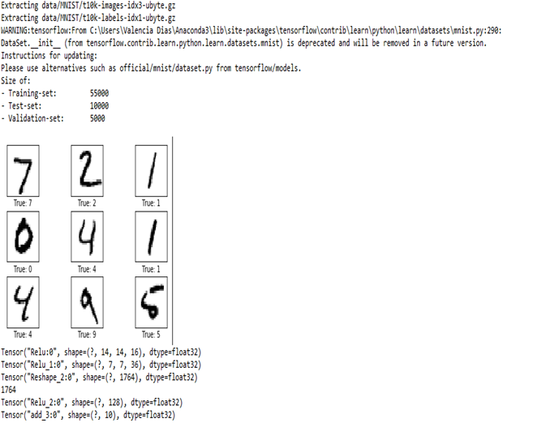
Training set: a set of examples used for learning, we use the training set to find the “optimal” weights with the back-prop rule
Validation set: a set of examples used to tune the parameters of a classifier use the validation set to find and the “optimal” number of hidden units or determine a stopping point for the back-propagation algorithm
Test set: a set of examples used only to assess the performance of a fully-trained classifier

Slide 17
Rectilinear unit activation - ReLU activations are the simplest non-linear activation function you can use, obviously. When you get the input is positive, the derivative is just 1, so there isn't the squeezing effect you meet on backpropagated errors from the sigmoid function. Research has shown that ReLUs result in much faster training for large networks.
Softmax classifier-(logistic regression)- Returns list of probabilities for each of 10 class labels. Higher probability class label is the final classification from n/w
Cross Entropy loss function- Measures the performance of classification model. It increases as the predicted probability diverges from actual label
Adam Optimisation function-The method computes individual adaptive learning rates for different parameters from estimates of first and second moments of the gradients.

Slide 18
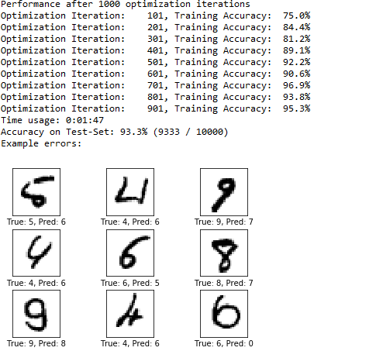
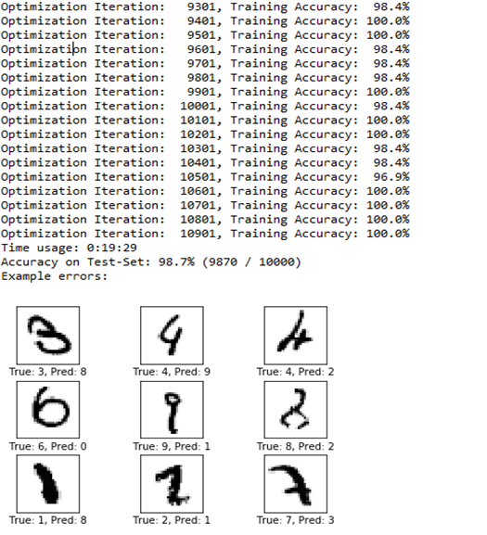
Performance after 1000 optimisation iterations
Performance after 10,000 optimisation iterations

Slide 19
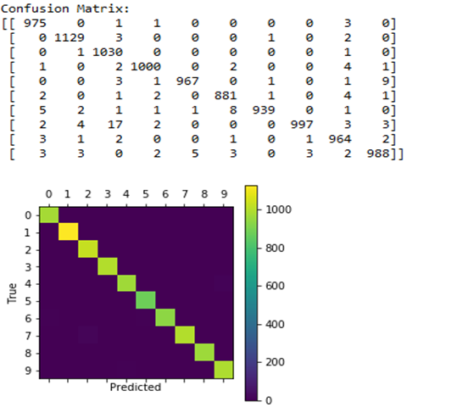
Confusion matrix
A confusion matrix is a summary of prediction results on a classification problem.
The number of correct and incorrect predictions are summarized with count values and broken down by each class. This is the key to the confusion matrix.
The confusion matrix shows the ways in which your classification model is confused when it makes predictions.

Slide 20
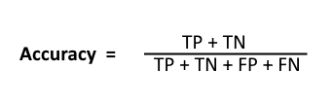
• Positive (P) : Observation is positive (for example: is an apple). • Negative (N) : Observation is not positive (for example: is not an apple). • True Positive (TP) : Observation is positive, and is predicted to be positive. • False Negative (FN) : Observation is positive, but is predicted negative. • True Negative (TN) : Observation is negative, and is predicted to be negative. • False Positive (FP) : Observation is negative, but is predicted positive.

Slide 21
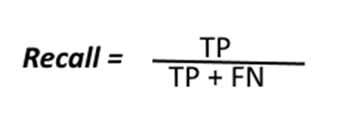

Recall: Recall can be defined as the ratio of the total number of correctly classified positive examples divide to the total number of positive examples. High Recall indicates the class is correctly recognized (small number of FN).
Precision: To get the value of precision we divide the total number of correctly classified positive examples by the total number of predicted positive examples. High Precision indicates an example labeled as positive is indeed positive (small number of FP).

Slide 22
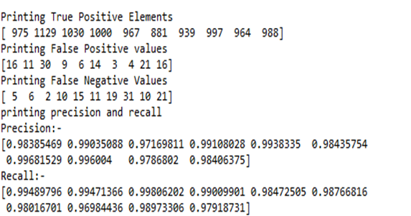
High recall, low precision: This means that most of the positive examples are correctly recognized (low FN) but there are a lot of false positives.
Low recall, high precision:
This shows that we miss a lot of positive examples (high FN) but those we predict as positive are indeed positive (low FP)

Slide 23
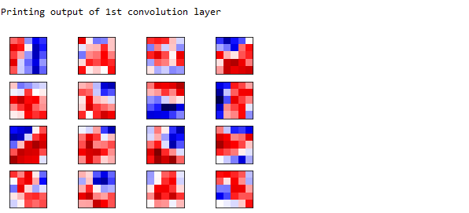
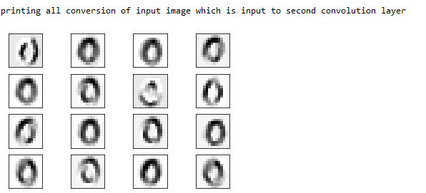

Slide 24
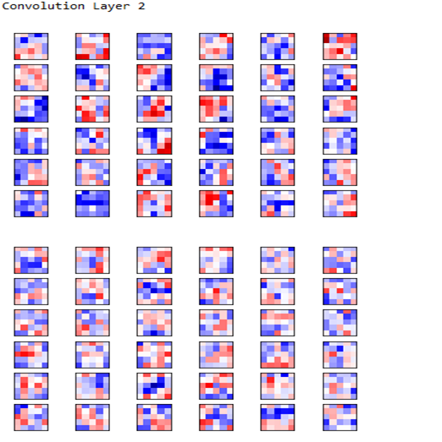
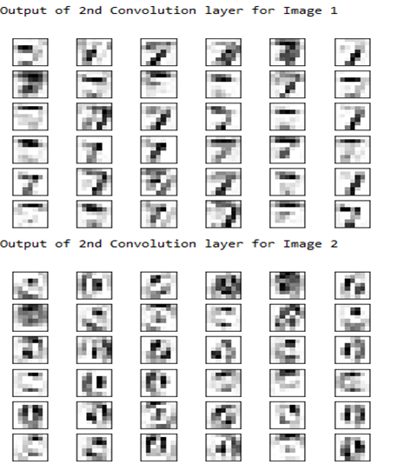

Slide 25
Future Enhancement
1. The work specifically belongs to isolated Digits with assumption that the images are of good quality and therefore complex normalization, skew removal and slant removal operations are not performed.
2. We would try to improve the learning and classification tasks, by the use of techniques like network pruning and variations in connection.
3. The developed model can be further extended for the holistic approach of conjunct/ word recognition.
4. The use of other training sets like alphanumeric character sets is an important challenge.

Slide 26
Conclusion
In our project we have applied convolutional neural network algorithm to the handwritten digits. Our goal was to recognize the handwritten digits from the MNIST dataset.
Using the Convolutional Neural Network with Keras and TensorFlow as backend, we are able to get an accuracy of 98.7%. Every tool has its own complexity and accuracy.
The complexity of the code and the process is bit more as compared to normal Machine Learning algorithms but looking at the accuracy achieved, it can be said that it is worth it.
The recognition system is also able to recognize the images as quickly as possible for this large dataset.
As the accuracy achieved is very high which means the error rate is very small in comparison to the neural network algorithm and other machine learning algorithms. Also, the current implementation is done only using the CPU.

